Slide 1
Working of Automated Machine

Slide 2
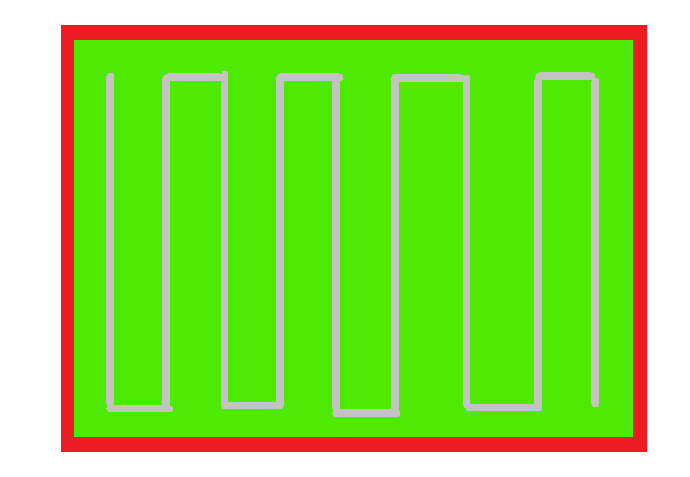




Slide 21


Slide 22


